Slide 1

Medicore: A Cross-Platform Medical Management Application
Name: Nazmus Sakib
ID: 2102066
Reg: 101093

Slide 2





Project Overview: Medicore
Medicore is a Flutter-based medical appointment and e-prescription application designed for both patients and doctors. It provides comprehensive features like appointment scheduling, video consultations, digital prescriptions, and patient history tracking, all integrated with secure payment support for a seamless healthcare experience.
Simplify Appointments
Secure E-Prescriptions
Streamline booking and management for all users, reducing wait times and administrative burden.
Enable digital prescriptions and comprehensive patient history tracking for improved accuracy and accessibility.
Integrate Payments
Improve Communication
Provide secure and convenient payment options for online and offline consultation fees.
Facilitate direct and secure patient-doctor interaction through in-app chat and real-time notifications.

Slide 3
Addressing Healthcare Challenges
Existing medical management solutions are often fragmented and lack comprehensive features, leading to inefficiencies and patient dissatisfaction. Medicore aims to solve key pain points for both patients and healthcare providers.
Fragmented Records
Inefficient Scheduling
Lack of Digital Prescriptions
Scattered health information across various providers leads to incomplete patient profiles and potential medical errors.
Manual appointment processes and long wait times cause frustration for both patients and clinic staff.
Over-reliance on paper prescriptions increases the risk of loss, illegibility, and medication errors.
Limited Communication
Payment Hurdles
Challenges in direct, secure patient-doctor interaction hinder timely medical advice and follow-ups.
Inconvenient payment methods often require physical presence, adding unnecessary friction to the healthcare journey.

Slide 4
Related Work & Medicore's Scope
While numerous applications address specific aspects of medical management, Medicore offers a unified, comprehensive solution that integrates various functionalities into a single platform.
Current Limitations
Medicore's Scope
Telehealth platforms often lack robust patient record management.
Initial Version Focuses On:
Comprehensive appointment scheduling and management.
Hospital and clinic-specific applications are frequently siloed and not interoperable.
Secure e-prescriptions and digital medical records.
Medication reminder apps typically do not integrate with appointment scheduling.
Robust user authentication and role-based dashboards for patients and doctors.
Personal health record apps often lack direct booking capabilities with healthcare providers.
Integrated payment processing for consultations.
Future Extensions:
Integration with wearable health devices.
AI-powered symptom analysis and preliminary diagnosis assistance.
Deeper integration with existing Electronic Health Record (EHR) systems.

Slide 5






Methodology & Technology Stack
Medicore will be developed using an agile methodology, ensuring iterative improvements and continuous integration of user feedback. This approach allows for flexibility and responsiveness to evolving requirements.
Frontend
Backend
Flutter (Dart) for high-performance, cross-platform mobile application development, ensuring native-like experiences on both iOS and Android.
Firebase (authentication, real-time database) or a custom PHP + MySQL solution for scalable and secure server-side operations.
Database
Payment Gateway
Firestore (NoSQL) for flexible, real-time data synchronization or MySQL (relational) for structured data management, depending on specific data needs.
SSLCommerz for secure and localized payment processing, facilitating seamless transactions for users.
Notifications
UI/UX Design
Firebase Cloud Messaging (FCM) for real-time alerts and push notifications, ensuring users receive timely updates.
Figma for collaborative wireframing, prototyping, and high-fidelity mockups, ensuring an intuitive and visually appealing user interface.

Slide 6
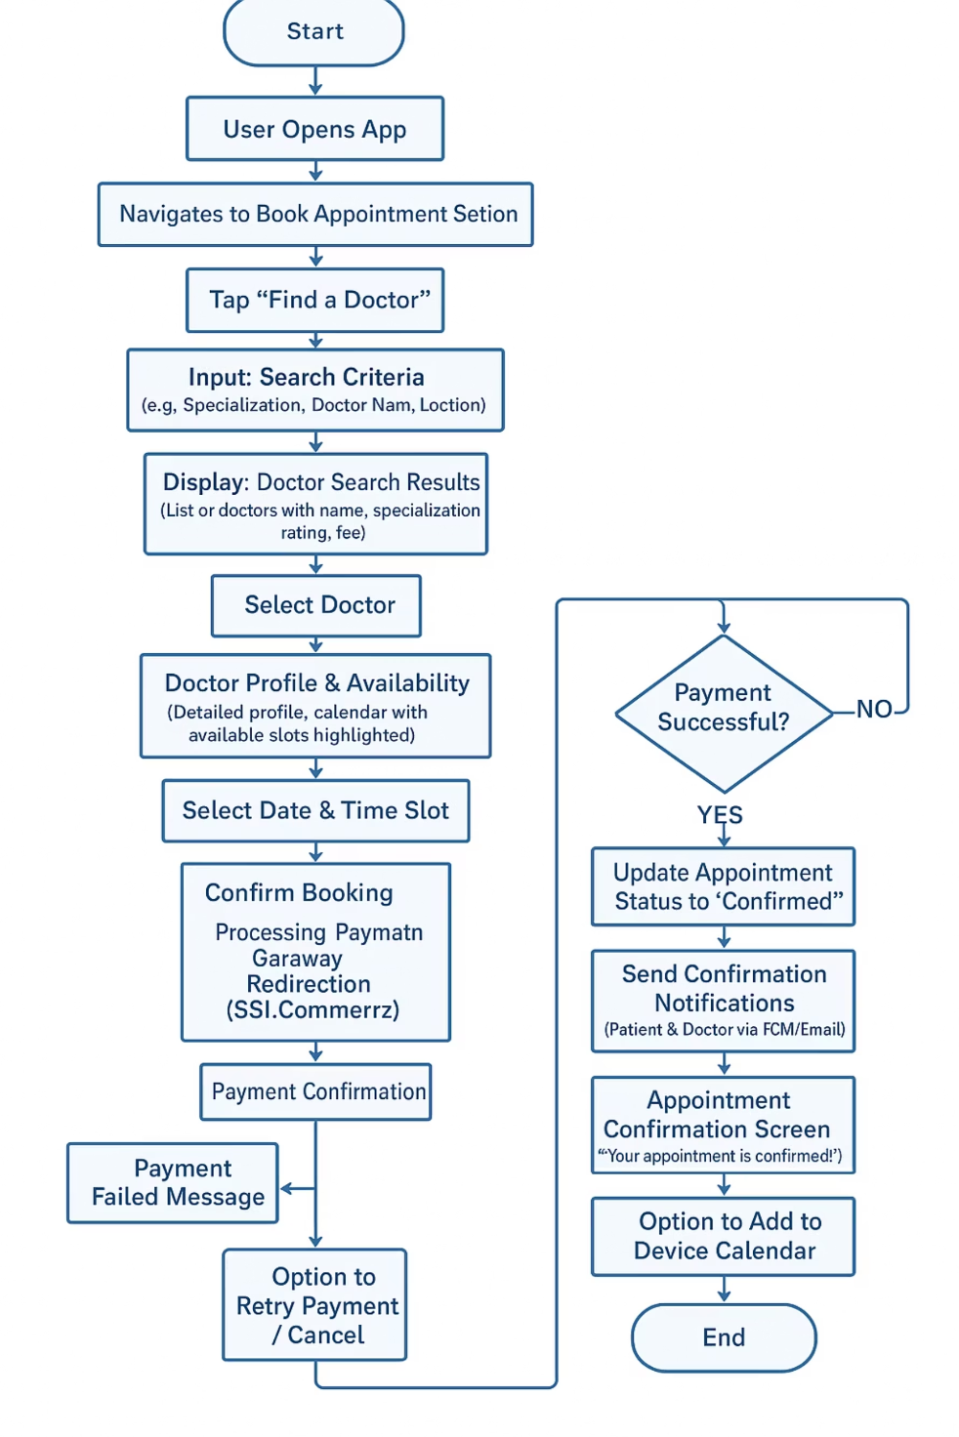
Design Principles & Visual Models
Medicore's design is meticulously crafted to prioritize an exceptional user experience, visual consistency, and robust security from the ground up.
Design Principles
Visual Models
User-Centric Design: Intuitive navigation and ease of use are paramount, ensuring a smooth experience for all users.
Material/Cupertino Design: Adopting platform-specific design guidelines (Material Design for Android, Cupertino for iOS) ensures a consistent and familiar UI/UX on each operating system.
Responsive Design: The application will provide a seamless experience across various screen sizes and devices, from smartphones to tablets.
Security & Privacy by Design: Robust security measures are integrated from the initial design phase, protecting sensitive health data.
Accessibility: Designed to be inclusive, ensuring the application is usable by individuals with varying abilities and needs.

Slide 7
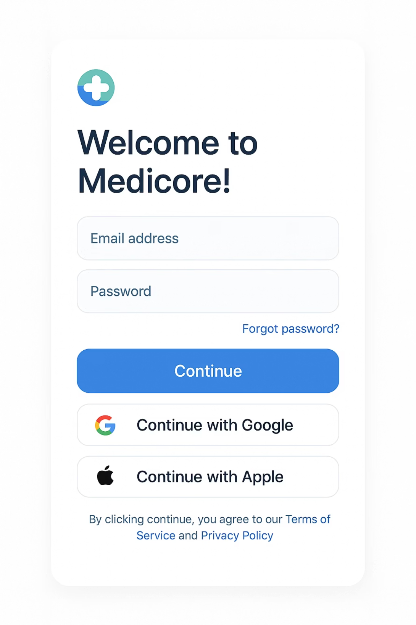
Development Timeline & UI Mockups
The Medicore project follows a structured timeline, from initial discovery to deployment and ongoing iteration, ensuring a systematic and efficient development process.
Key Phases
Phase 1: Discovery & Planning (5 weeks): Comprehensive requirement gathering and project scope definition.
Phase 2: UI/UX Design & Prototyping (9 weeks): Creation of wireframes, mockups, and interactive prototypes based on user research.
Phase 3: Core MVP Development (12 weeks): Building the Minimum Viable Product with essential features.
Phase 4: Testing & Quality Assurance (12 weeks): Rigorous testing, bug fixing, and performance optimization to ensure a stable application.
Phase 5: Deployment & Launch (5 weeks): Preparing for and releasing the application to target platforms.
Phase 6: Post-Launch & Iteration (Ongoing): Continuous monitoring, user feedback integration, and feature enhancements.

Slide 8
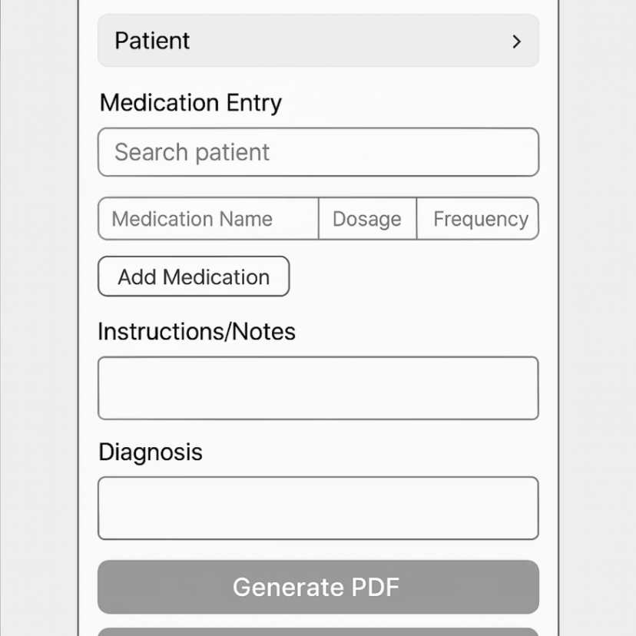
Limitations & Conclusion
Medicore is poised to be a transformative digital solution in healthcare, prioritizing user convenience and robust security. While the initial version has some limitations, our commitment to data protection and regulatory adherence is foundational.
Current Limitations
Security & Compliance
No browser extensions are planned for the initial release, focusing solely on mobile applications.
Data Encryption (SSL/TLS): All data in transit and at rest will be encrypted to protect sensitive patient information.
The initial MVP primarily focuses on core functionalities, with advanced features to be introduced in subsequent updates.
Strong Authentication & Authorization: Implementing robust user authentication and role-based access control to ensure data integrity and privacy.
Extensive offline capabilities will be limited in the MVP, with plans for expansion in future iterations.
Regular Security Audits: Conducting frequent security assessments and penetration testing to identify and mitigate vulnerabilities.
Regulatory Adherence (HIPAA, GDPR): Ensuring compliance with relevant healthcare data privacy regulations such as HIPAA and GDPR.
Secure API Design & Audit Trails: Designing secure APIs and maintaining comprehensive audit trails for all data access and modifications.

Slide 9

Thank You
We appreciate your time and consideration. Medicore is set to transform healthcare management through intuitive design and robust technology.
For questions or further discussion, please feel free to reach out.

